Slide 1
DATA
ANALYSIS
Data ANALYSIS
Supply chain management system for hospital
Arnav Gupta – RA2211027010125
Aditii Sharma – RA2211027010093
Parth Bhunia – RA2211027010096

Slide 2
Introduction
data
ANALYSIS
Data ANALYSIS
The provided code implements a supply chain management system for a hospital, focusing on forecasting demand, optimizing costs, and planning distribution routes for medical supplies.
It allows users to input orders and supplier information, perform demand forecasting, optimize costs based on supplier pricing, and plan distribution routes within a specified budget and current stock level.

Slide 3
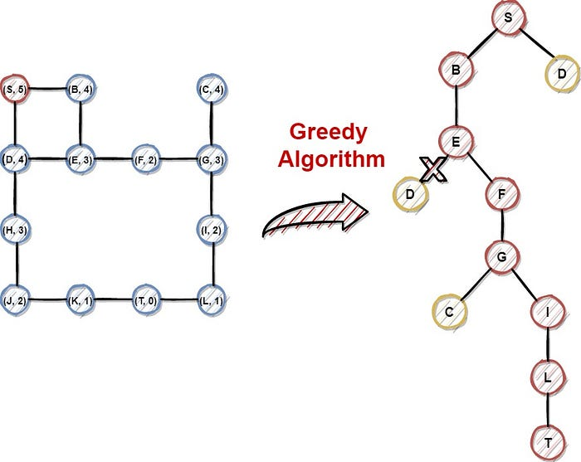
Algorithm Design Technique
data
ANALYSIS
Data analysis
The algorithm design technique used in this code is:
Greedy Algorithm: The route planning method employs a greedy approach to select distribution routes. It iterates through sorted orders based on priority and selects orders that can be fulfilled within the maximum budget and current stock level, minimizing costs.

Slide 4
Algorithm
sorting
Iteration
Return
DATA
ANALYSIS
Data ANALYSIS
Sort orders based on priority in descending order.
Initialize an empty list for distribution routes.
If the cost of adding the order to the distribution route does not exceed the maximum budget and the order's quantity can be fulfilled with the current stock level, add the order to the distribution routes and update the current stock level.
Return the selected distribution routes.

Slide 5
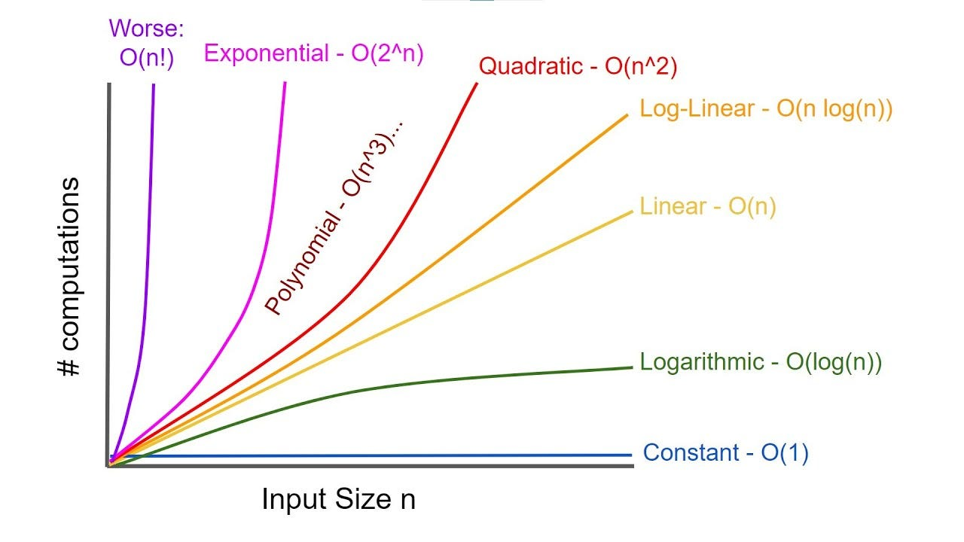
Time Complexity Analysis
Best Case: O(n log n)
Average Case: O(n log n)
01
02
Worst Case: O(n log n)
03
data
ANALYSIS
Data ANALYSIS
Sorting the orders based on priority.
Sorting the orders based on priority.
Sorting the orders based on priority.

Slide 6
Comparative Study with Other Algorithms
Dynamic programming
Branch and bound dynamic programming
data
ANALYSIS
Data ANALYSIS
Breaks down the problem into smaller subproblems and solves them recursively.
Challenging to implement due to defining subproblems and handling overlapping subproblems.
Time complexity ranges from O(n^2) to O(2^n), depending on memoization or tabulation efficiency.
Systematically searches the solution space, pruning branches that cannot lead to better solutions.
Explores different distribution route combinations to minimize costs while meeting constraints.
Time complexity varies from exponential (O(b^d)) to polynomial (O(n^k)), depending on pruning effectiveness.
VS

Slide 7
REsult
data
ANALYSIS
Data ANALYSIS
Dynamic Programming and Branch and Bound offer alternative approaches for optimizing distribution routes.
Dynamic Programming requires careful subproblem definition and may have exponential time complexity.
Branch and Bound can provide optimal solutions but may have high computational complexity, especially in the worst case.
Greedy Algorithm remains efficient for small to medium-sized instances, balancing simplicity and performance.

Slide 8
PSEUDOCODE:
DATA
ANALYSIS
Data ANALYSIS
1. Initialize Supply Chain Management Object:
- Create a class named Supply Chain Management with orders and suppliers attributes.
2. Demand Forecasting:
- For each order, prompt user input for forecasted quantity and update the order data.
3.Optimize Costs
- Calculate total cost for each supplier based on forecasted quantities and price per unit.
4. Route Planning
- Sort orders by priority.
- Iterate over orders:
- Check if adding the order to distribution route keeps total cost within budget.
- Add order to route if cost is within budget and current stock is sufficient.
5. Input Data and Execution:
- Input order and supplier data, budget, and current stock.
- Create Supply Chain Management instance.
- Execute demand forecasting, cost optimization, and route planning methods.
- Display selected distribution routes.

Slide 9

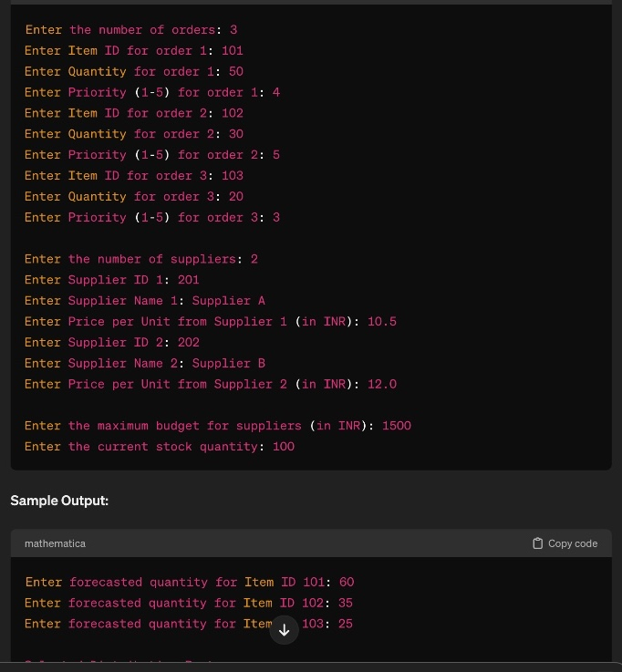
DATA
ANALYSIS
Data ANALYSIS
OUTPUT:

Slide 10
THANKYOU

